Slide 1
DEPARTMENT OF ELECTRONICS AND INSTRUMENTATION ENGINEERING
AIR QUALITY
MONITORING SYSTEM
Using Arduino uno and
mq135 gas sensor
BY,
G. DHEEPIGHA,
T. JAYAPRIYA,
K. PAVITHRA.
BE . EIE ii YEAR

Slide 2
CONTENTS
Introduction
Abstract
Components
Working
Result
Arduino Code
Advantage and disadvantages
Future Enhancement
Conclusion
Thank You

Slide 3
INTRODUCTION
The Air Quality Monitoring System is designed to continuously assess air quality and present the results in a user-friendly manner.
By employing an MQ-135 gas sensor, which measures the concentration of harmful gases in the environment, the system can accurately determine the air quality.
The system's operation is intuitive and user-friendly. It displays the air quality in a visual and informative way, using a threshold value as a reference.
Additionally, the system prints the exact air quality value.
The Air Quality Monitoring System is an invaluable tool for homeowners, workplaces, and public spaces, enabling everyone to monitor and maintain a safe and healthy environment.

Slide 4
ABSTRACT
The Air Quality Monitoring System is a significant innovation in the realm of environmental sensing and data visualization.
This project leverages the power of an Arduino UNO microcontroller, an MQ-135 gas sensor, a breadboard, connecting jumper wires, an LED, a buzzer, a 16x2 LCD monitor, and an array of components to create a comprehensive solution for monitoring air quality.
Air quality has a profound impact on our health and well-being, making it vital to keep a close eye on its status. This system not only detects air quality but also provides real-time feedback, indicating whether the air quality falls within acceptable levels.

Slide 5
NEED FOR AIR QUALITY MONITORING
.
Air quality monitoring is an important tool for
improving air quality,
protecting public health, and
ensuring compliance with regulations.
It can also be used to identify pollution sources,
monitor climate change, or support research
and development.

Slide 6
Arduino UNO
USB cable
Gas Sensor (MQ 135)
Potentiometer
16x2 LCD panel
Jumper wires
RESISTOR (220 Ohm)
BUZZER
LED
COMPONENTS

Slide 7
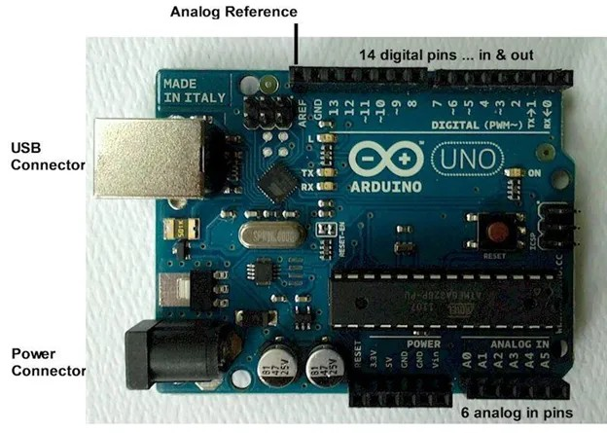
ARDUINO UNO

Slide 8
ARDUINO UNO
Arduino is an open-source computer hardware and software
company, project, and user community that designs &
manufactures single-board microcontrollers & microcontroller
kits for building digital devices and interactive objects
that can sense and control objects in the physical world.
The microcontrollers are typically programmed using
the programming languages C and C ++.

Slide 9
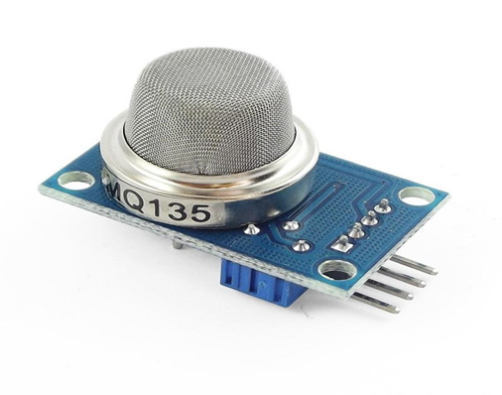
GAS SENSOR (MQ 135)
Air quality click is suitable for detecting ammonia (NH3),
nitrogen oxides (NOx) benzene, smoke, CO2, and other harmful
or poisonous gases that impact air quality.
The MQ-135 sensor unit has a sensor layer made of
tin dioxide (SnO2).
Pin Description
VDD
GND
DIGITAL OUT
ANALOG OUT

Slide 10
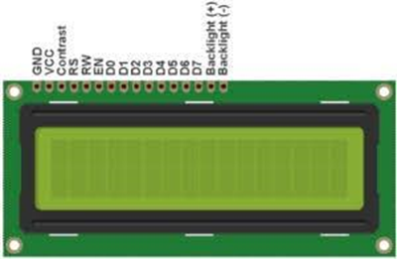
LCD Panel
A liquid-crystal display (LCD) is a flat-panel display or another
electronically modulated optical device that uses the
light-modulating properties of liquid crystals.
Liquid crystals do not emit light directly, instead of using
a backlight or reflector to produce images in color
or monochrome.
Pin description
Connect pins 1 to 16
where,
pin 1 is GND and
pin 2 is Vcc.

Slide 11
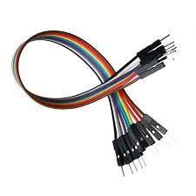
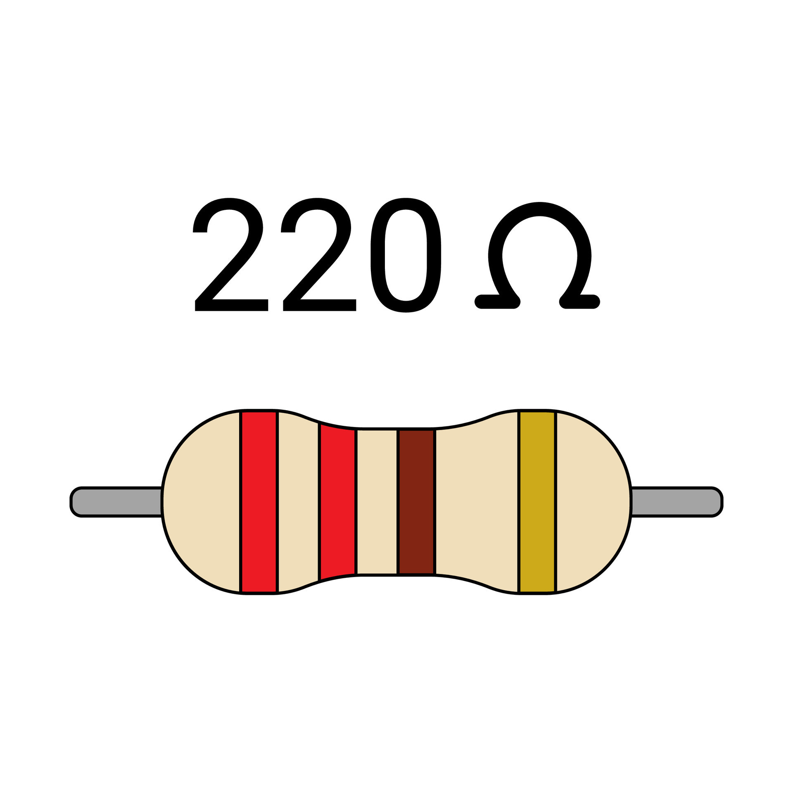
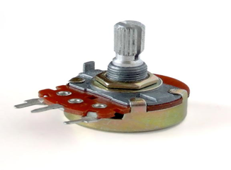
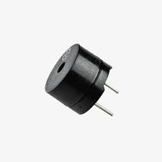
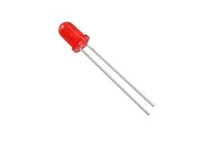
JUMPER WIRES
POTENTIOMETER
RESISTOR
BUZZER
LED

Slide 12
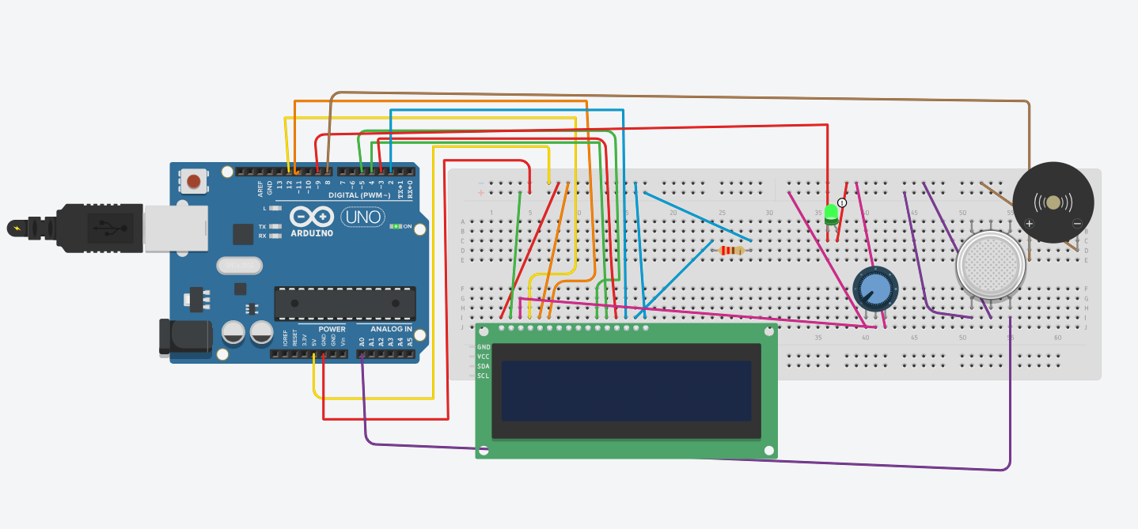
CIRCUIT DIAGRAM

Slide 13
WORKKING
The MQ135 gas sensor measures harmful gas concentrations in the environment.
The sensor's readings are calibrated for accuracy, accounting for environmental factors.
Arduino Uno processes the sensor data, converting it into an air quality index.
A 16x2 LCD visually displays air quality status in an easy-to-understand format.
When air quality falls below a threshold, a buzzer provides an audible alert, and an LED indicates the status.
Users can understand and respond to air quality conditions quickly.

Slide 14
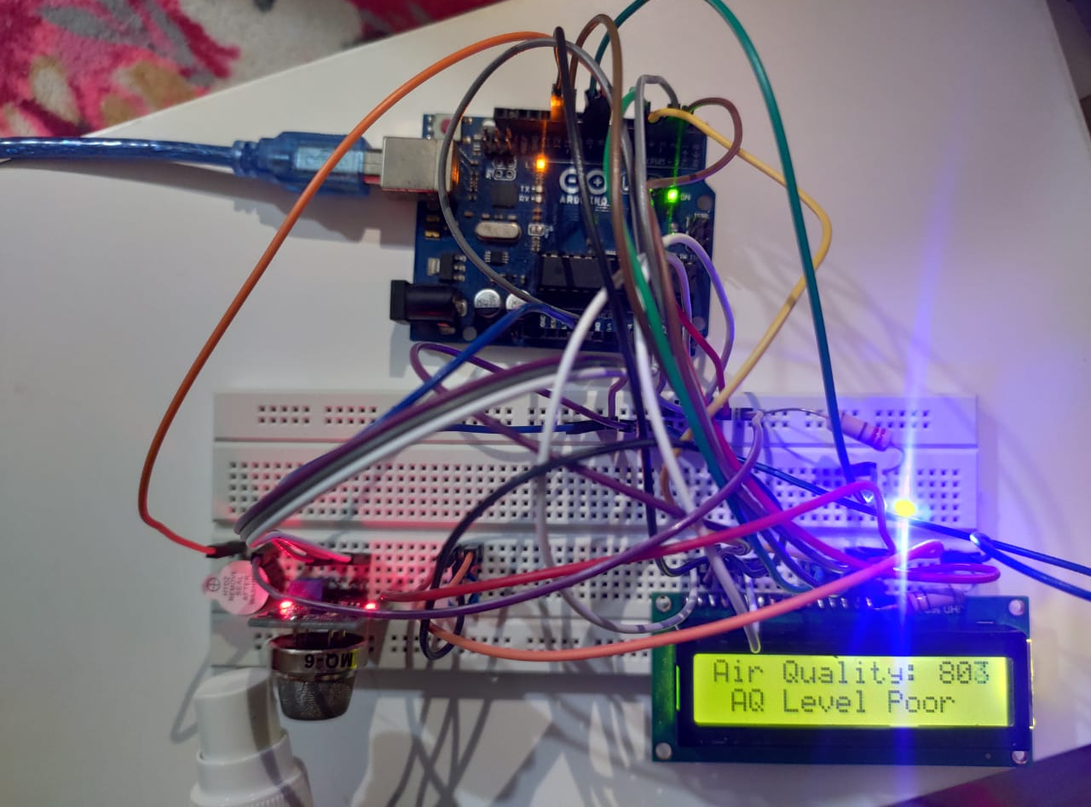
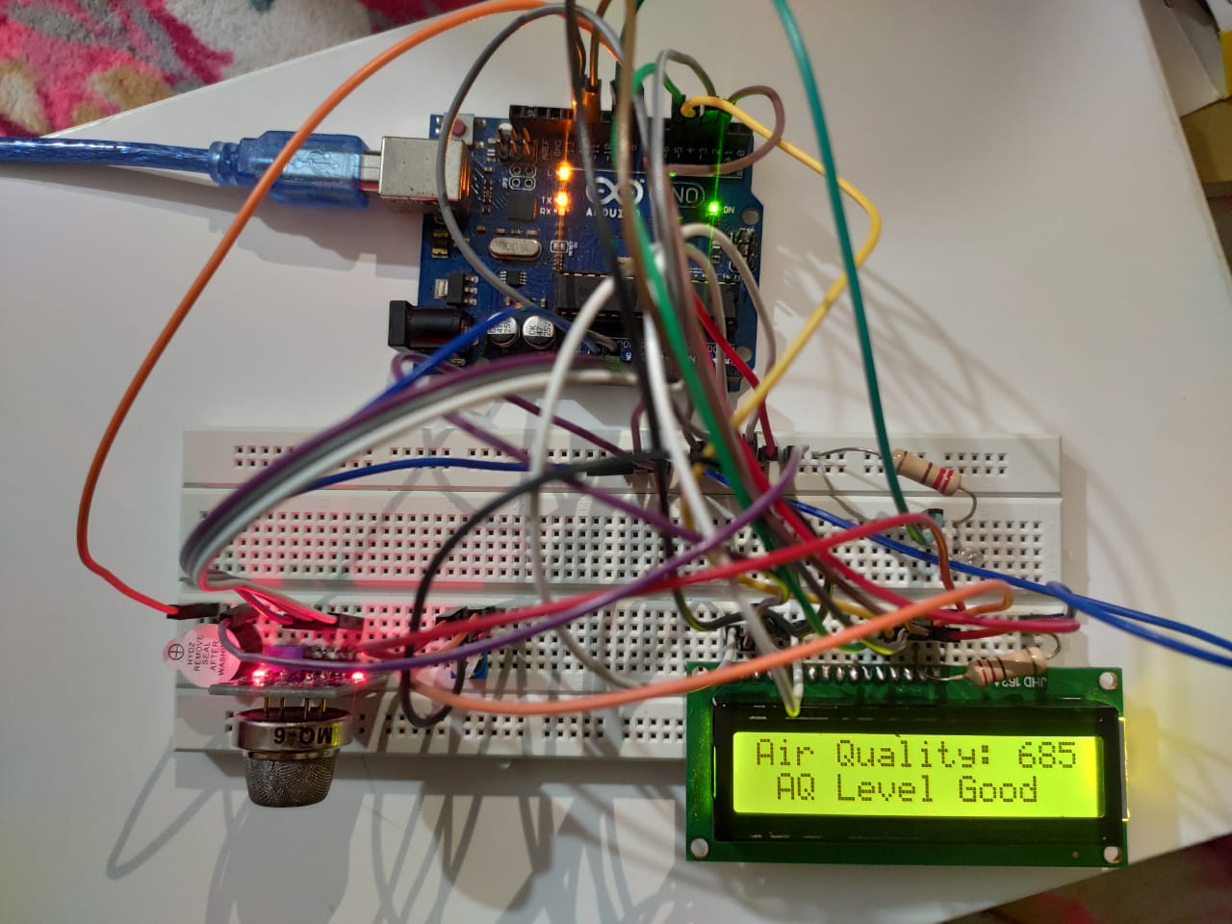
RESULT

Slide 15
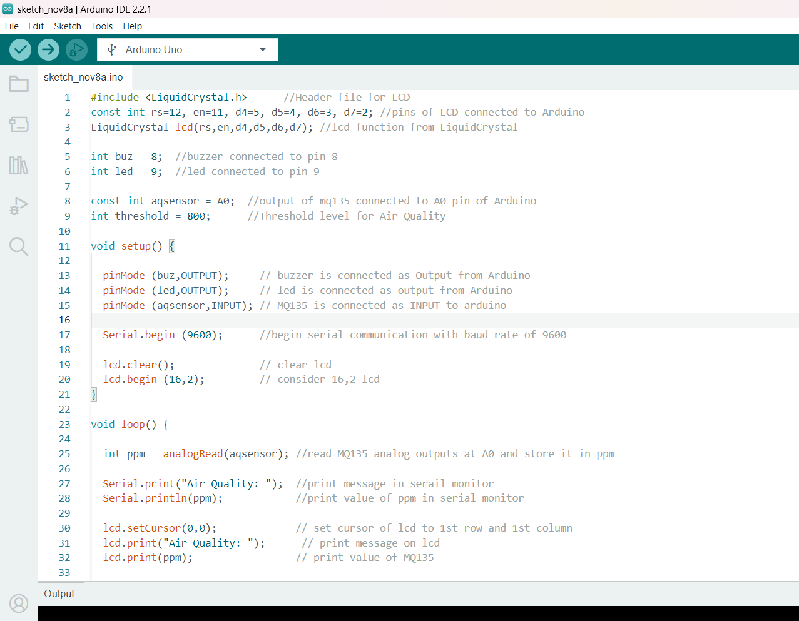
ARDUINO CODE

Slide 16
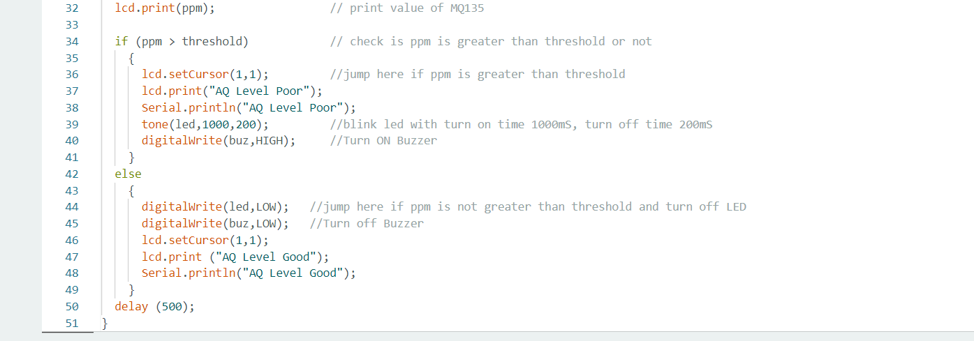
ARDUINO CODE

Slide 17
ADVANTAGES
Health awareness
User-Friendly
Alter System
Data Logging
Real-Time Monitoring
DISADVANTAGES
Regular maintenance is needed
Data security
Calibration
Technical knowledge
Limited sensing range

Slide 18
FUTURE ENHANCEMENT
1. Wireless Connectivity
2. Mobile App
3. Data Logging & Analytics
4. GPS Integration
5. Sensor Expansion
6. Advanced Notifications
7. Air Purification Control
8. Cloud Integration
Multi-Location Support
10. User-Configurable Thresholds
11. Predictive Analytics
12. Energy Efficiency Improvements

Slide 19
CONCLUSION
In conclusion, the Air Quality Monitoring System offers an effective and user-friendly solution for monitoring and maintaining air quality in various environments. By combining the power of an Arduino UNO, an MQ-135 gas sensor, and an array of components, it promotes health awareness, real-time monitoring, and data-driven decision-making. The customizable thresholds, alert system, and comprehensive approach make it a valuable tool.
While the system offers numerous advantages, it's essential to consider the associated costs, technical expertise, and maintenance requirements. Additionally, advanced features like data security and predictive analytics can add complexity.
In the end, the Air Quality Monitoring System empowers users to make informed choices, protect their health, and contribute to a cleaner environment. It represents a significant step toward ensuring the air we breathe is safe and healthy.

Slide 20

ANY QUERIES?

Slide 21

THANK YOU

